Slide 1
CN Presentation
Building a reliable data transfer protocol
By: Group 04

Slide 2
AGENDA
Introduction
Reliable Data Transfer Protocol
Building a RDT
rdt1.0
rdt2.0
rdt2.1
rdt2.2
rdt3.0
Conclusion

Slide 3
RDT
Introduction
What is Reliable data transfer protocol?
Why building a Reliable data transfer protocol?

Slide 4
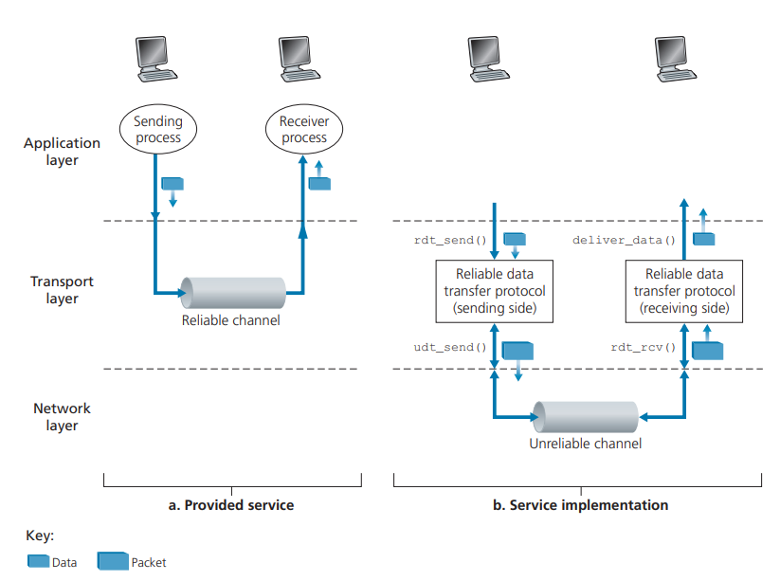
RDT
Provided service

Slide 5
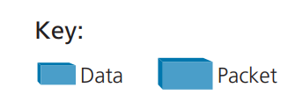
Difficulty in Implementation
Service offered by TCP
TCP is implemented over unreliable channel IP
Keys:

Slide 6
Before we get Started
Generic Term “Packet”
Best to Worst Case
Unidirectional Data Transfer
Half Duplex
“ᴧ” Symbol

Slide 7
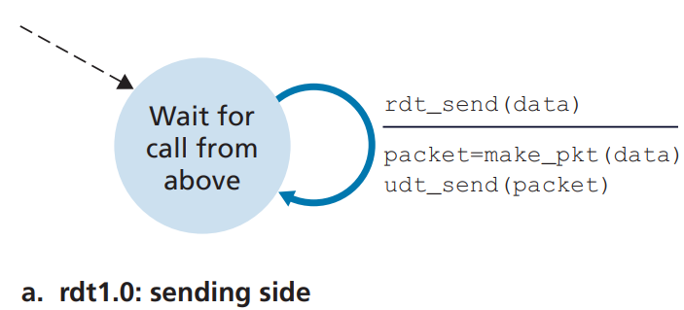
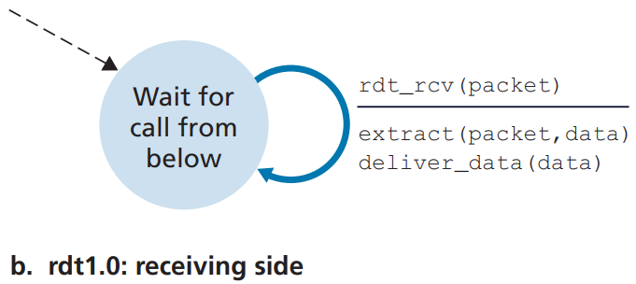
RDT over a Perfectly Reliable Channel: rdt1.0
FSM (Finite-state machine)
Sender and Receiver FDM’s
Sending side of rdt1.0 – procedure call from above
Receiving side of rdt1.0 – procedure call from below

Slide 8
RDT over a Channel with Bit Errors: rdt2.0
Bit in a packet may be corrupted
Occurs when the packet is transmitted, propagates or is buffered
Assuming that all the packets are received
How to deal with this situation on this Channel:- Example

Slide 9
ARQ
Automatic Repeat reQuest
Error Detection
Receiver feedback
ACK and NAK
Retransmission

Slide 10
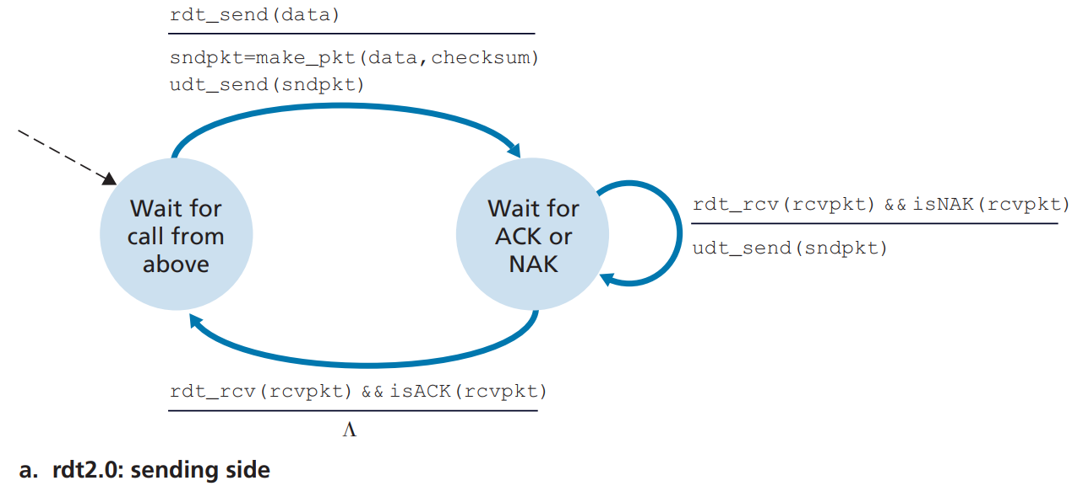
ARQ
rdt2.0: Sending Side
Sending side has 2 states now
Create a packet that contains data along with packet checksum
Stop-and-wait Protocols

Slide 11
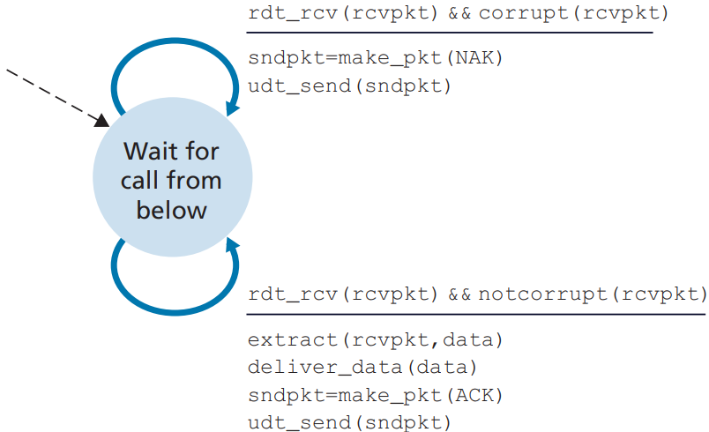
rdt2.0: Receiving Side
Receiver side still has a single state

Slide 12
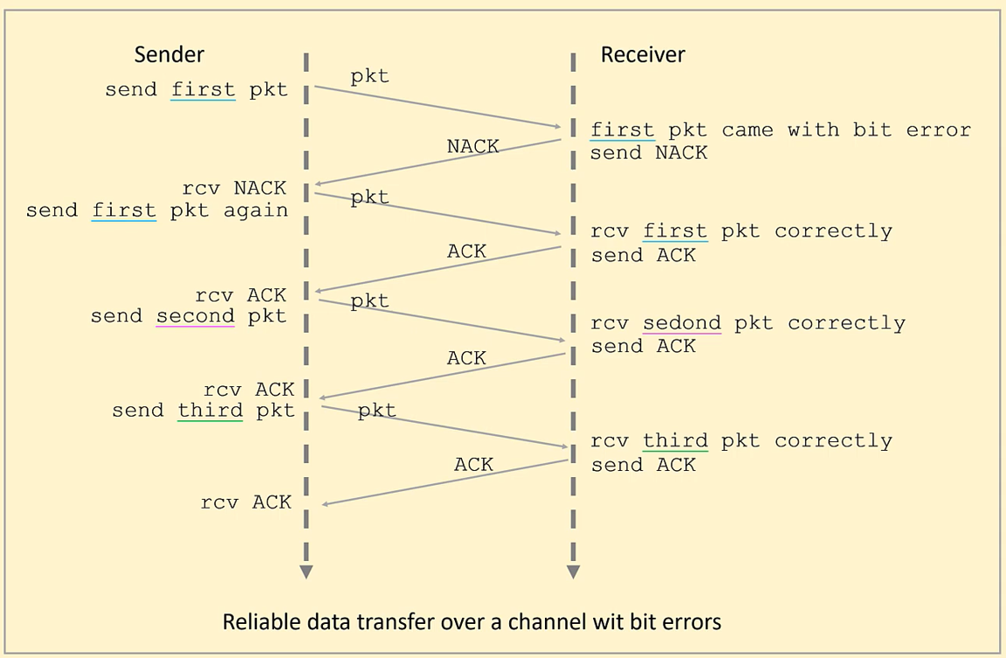
Mechanism

Slide 13
rdt2.0: Flaw
Possibility that the ACK or NAK might be corrupted
Corrupted bit can lead to unnecessary retransmissions
How the protocol should recover

Slide 14
3 Possibilities
Handling Corrupted ACK & NAK
Introducing a type of sender-to-receiver packet
Add enough checksum bits
Resend the current packet when it receives the garbled ACK or NAK

Slide 15
3 Possibilities
rdt2.1: Sequence Number
Add a new field to the data packet – Number
Introduces rdt2.1 – Fixed version of rdt2.0
Also uses ACK and NAK packets
The receiver now need to check this number to determine is it a retransmission or not

Slide 16
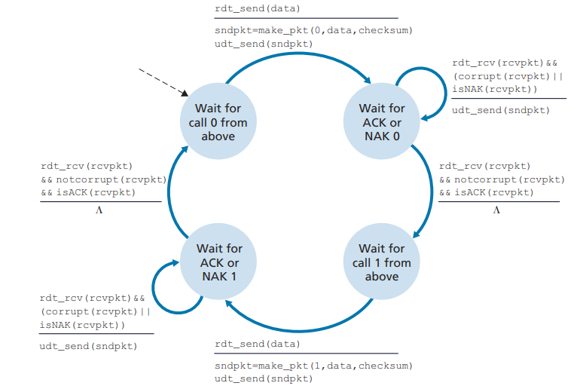
rdt2.1: Sender
Now checks the sequence number and determines whether the receiver has received correctly or not

Slide 17
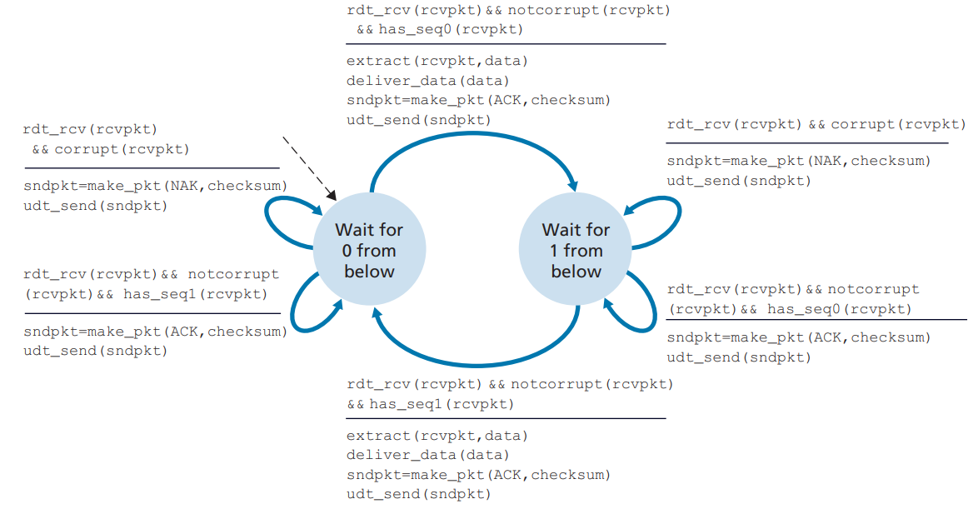
rdt2.1: Receiver
Check sequence number is 0 or 1
Correct or resent packet is received, the receiver sends a ACK
Corrupted packet is received, the receiver sends a NAK

Slide 18
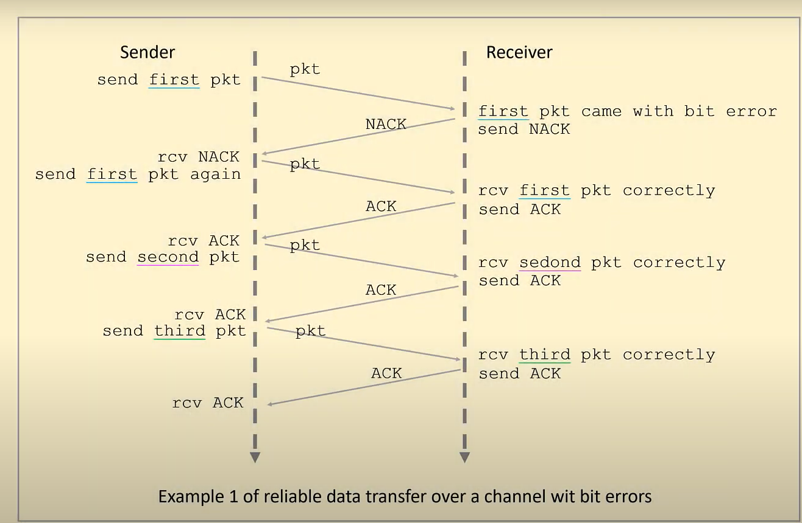
Mechanism

Slide 19
rdt2.1: Flaw
Twice as many states as before
How to solve this

Slide 20
NAK free
Introducing rdt2.2
This can be done without NAK
A sender that receives two ACKs for the same packet knows that the receiver did not correctly receive the packet following the packet that is being ACKed twice

Slide 21
NAK free
rdt2.2: Duplicate ACKs
The receiver must now include the sequence number of the packet being acknowledged by an ACK message
The sender must now check the sequence number of the packet being acknowledged by a received ACK message

Slide 22
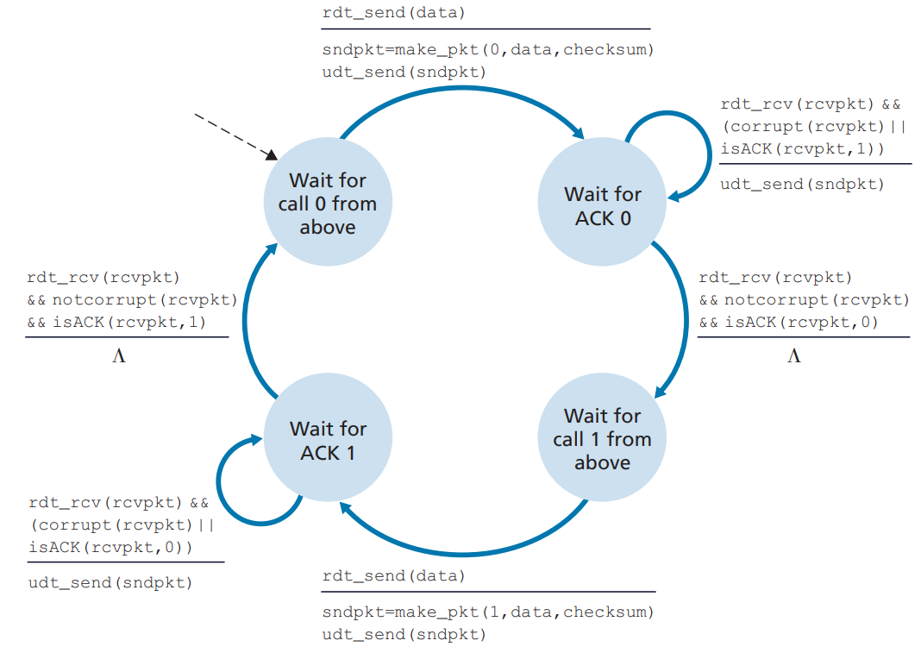
rdt2.2: Sender
isACK( ) is used to check the sequence number of ACK
If twice ACK is received of the different sequence number the sender will resend the packet

Slide 23
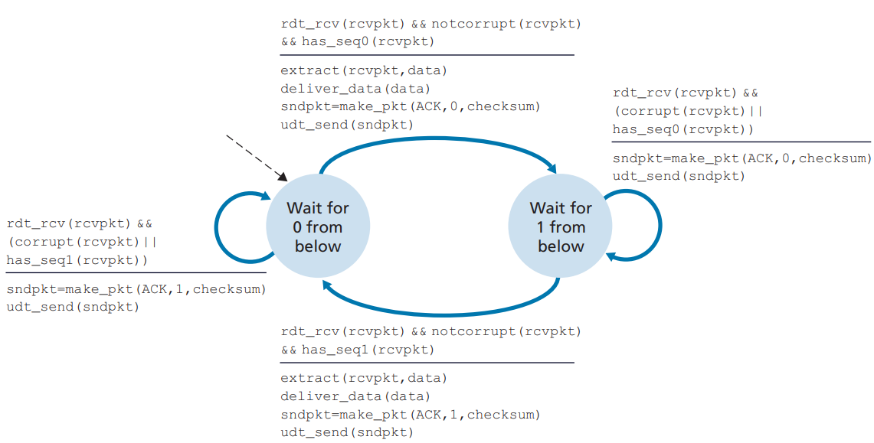
rdt2.2: Receiver
Now the receiver will include the sequence number in ACK packet

Slide 24
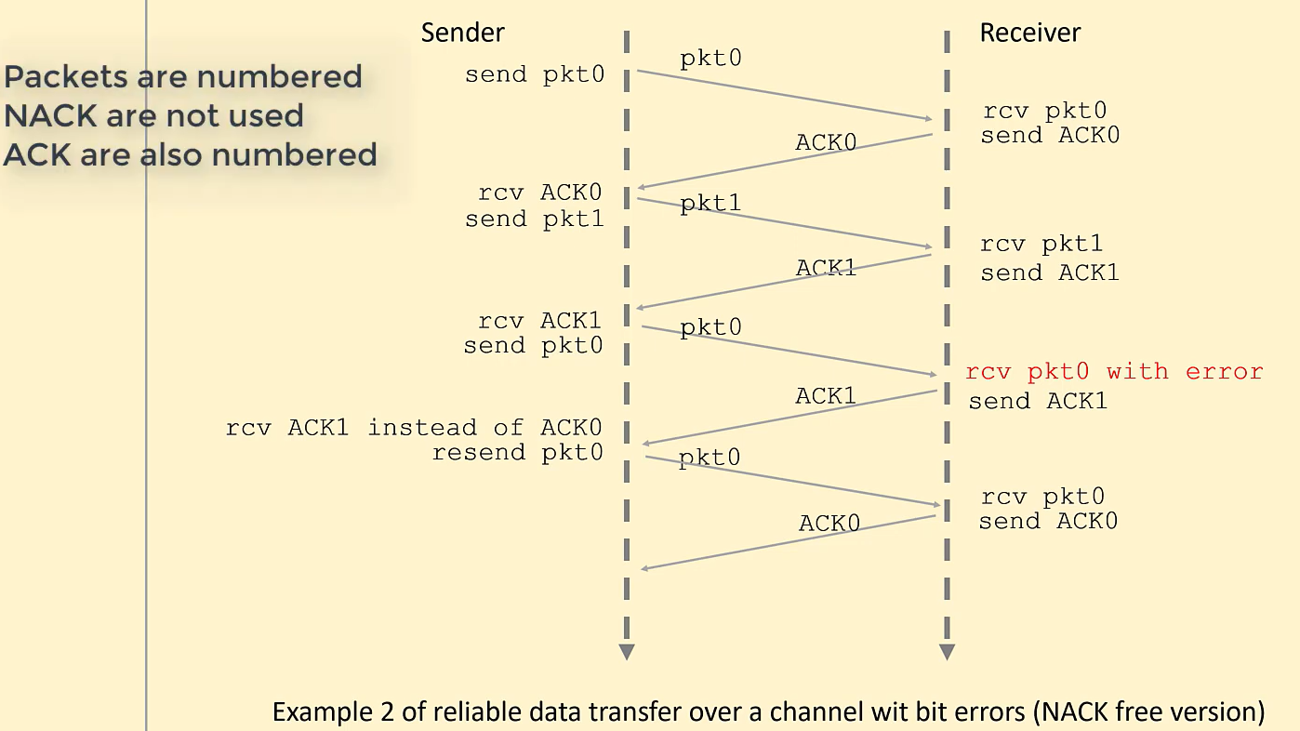

Slide 25
RDT over a Lossy Channel with Bit Errors: rdt3.0
The underlying channel can lose packets
How to detect packet loss and what to do when packet loss occurs?

Slide 26
Detecting and recovering from lost packets
Resend
If no reply is forthcoming at the sender from the receiver wait and resend the packet
How long…?

Slide 27
Resend
rdt3.0: Waiting and Resend
If packet lost then sender or receiver will have to wait.
In worst-case maximum delay of the waiting time will be infinity and difficult to estimate
The protocol should ideally recover from packet loss as soon as possible.

Slide 28
rdt3.0: Countdown Timer
Implementing a time-based retransmission mechanism requires a countdown timer.
Resend

Slide 29
rdt3.0: Sender Job
Put the burden on sender
The sender will :
(1) start the timer each time a packet
(2) respond to a timer interrupt
(3) stop the timer
Because packet sequence numbers alternate between 0 and 1, protocol rdt3.0 is sometimes known as the alternating-bit protocol.

Slide 30
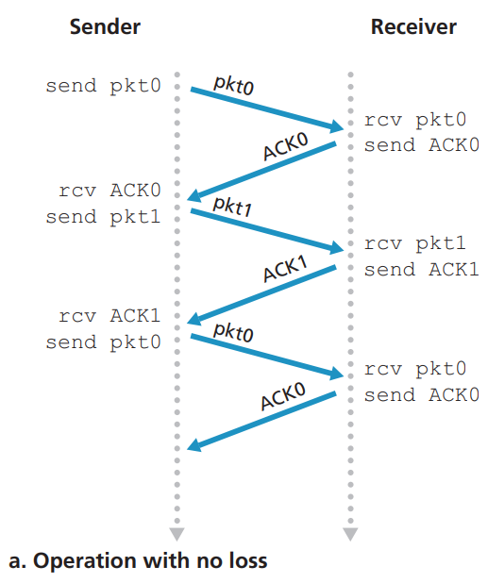
rdt3.0: Operation with no loss

Slide 31
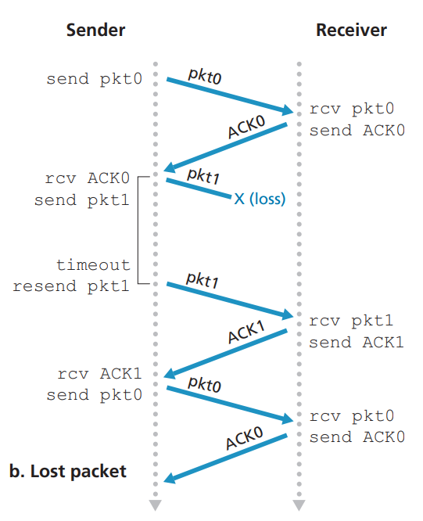
rdt3.0: Packet Loss

Slide 32
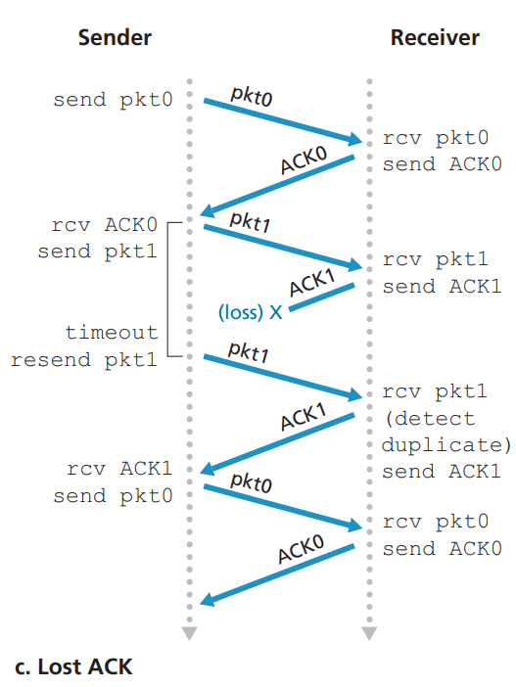
rdt3.0: ACK Lost

Slide 33
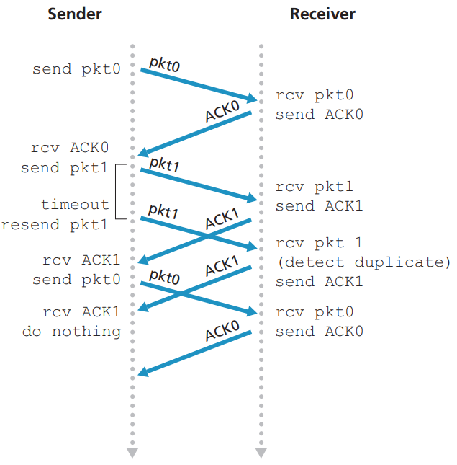
rdt3.0: Premature Timeout

Slide 34
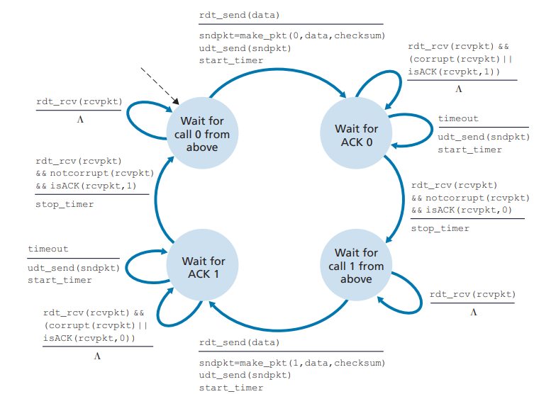
rdt3.0: Sender
Time moves forward from the top of the diagram toward the bottom of the

Slide 35
Conclusion
1.0
2.0
2.1 2.2
3.0
Ideal
Bit Corrupt
Feedback Issue
Packet Lost
RDT with no issue (can’t exists)
Checksum bits
Sequence Number ACK and NAK Retransmission
Countdown timer

Slide 36
Thanks

